Slide 1

COVID CARE
Final Project by:
Shreya Ghate (001502858)
Ayush Gupta (001554875)
Pradnyal Gandhi (001095168)

Slide 2
Problem Statement
Since 2020, the entire world has got severely affected by the COVID-19 virus. This created a global health disaster. We suffered heavy losses in terms of lives lost, revenue, the medical ecosystem was greatly challenged during this crisis.
As of December 12, 2021, the number of both confirmed and presumptive positive cases of the COVID-19 disease reported in the United States had reached around 49.7 million and almost 794 thousand deaths were reported among these cases.

Slide 3
We believe that preventing further spread of COVID-19 through timely identification of positive cases and contacts to isolate or quarantine if indicated.
Along with COVID-19 tracking, it is equally important that the citizens affected or unaffected by this are been protected. The federal government seems poised to provide high-quality data on vaccinations, but it is crucial to build datasets about the current vaccinations and making sure the society is completely vaccinated to fight this brutal virus.

Slide 4
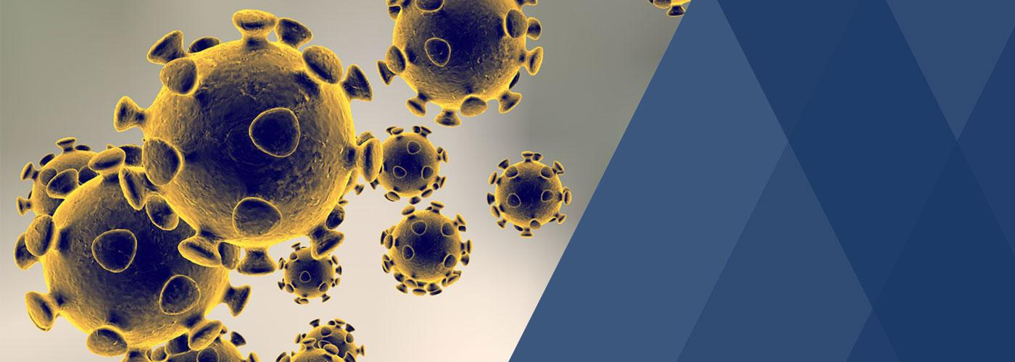
Our Approach: Your Shield for Safer Society
Our primary purpose of building this application was to create a platform for tracking vaccinations for the society as well as COVID-19 cases for your city. This will take the society in a world where we are ready to fight such global health dilemma

Slide 5
Our Ecosystem
The purpose of our ecosystem is to establish a network of cities that connects a person to an organization and enterprise consisting of Vaccination Center, Vaccine Manufacturer, Hospital and a Testing Lab. We have designed an ecosystem where we manage the entire Vaccine Distribution, Vaccination Status for the citizens, COVID-19 testing, admit Patients for Doctor consultation and tracking their Vital Signs
We have 4 Enterprises, 9 Organizations and 10 Roles
This demonstrates the robustness of our Ecosystem. We aim to provide an easy and user friendly workflow for a safer world for fighting Coronavirus

Slide 6
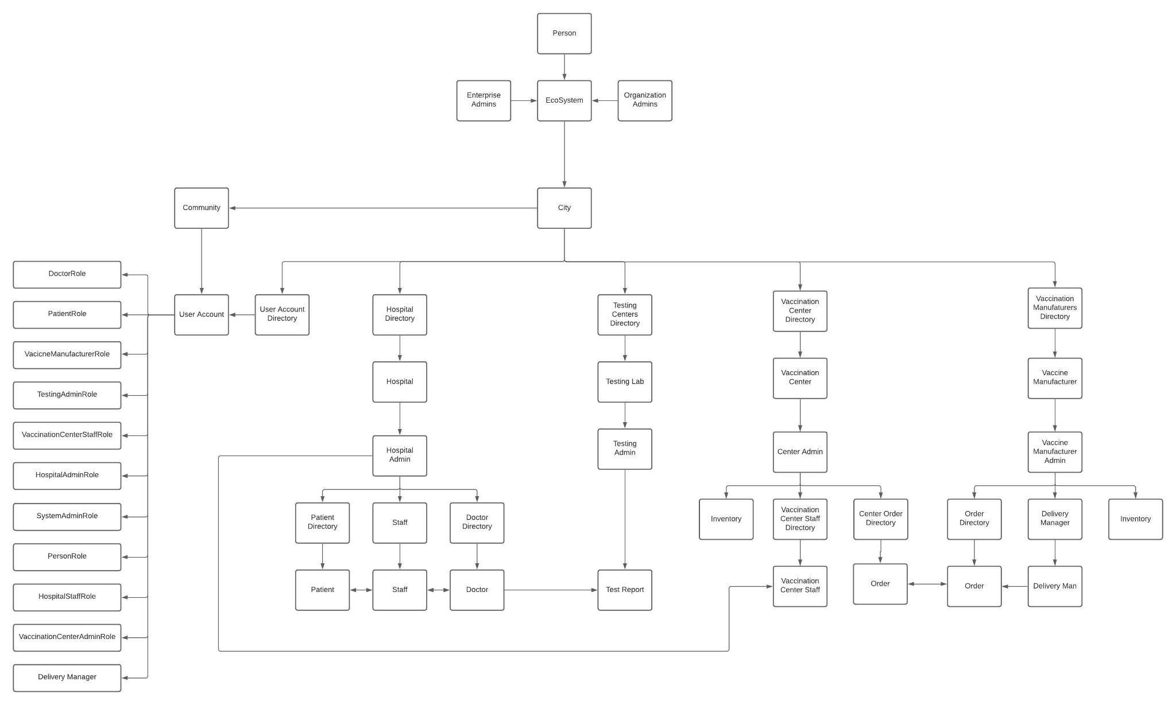

Slide 7
Key Features
Manage Hospital Recovery
COVID-19 Testing History
Vaccination Status
Manage Vaccine Inventory

Slide 8
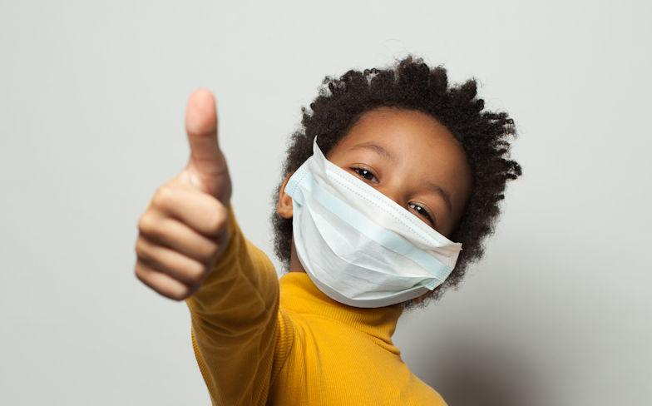
Future Scope
Contact Tracing using GPRS
In-depth Tracking
Online Doctor Consultation
Get Covid Recovery Tips
Making this a Global Health App for other diseases

Slide 9
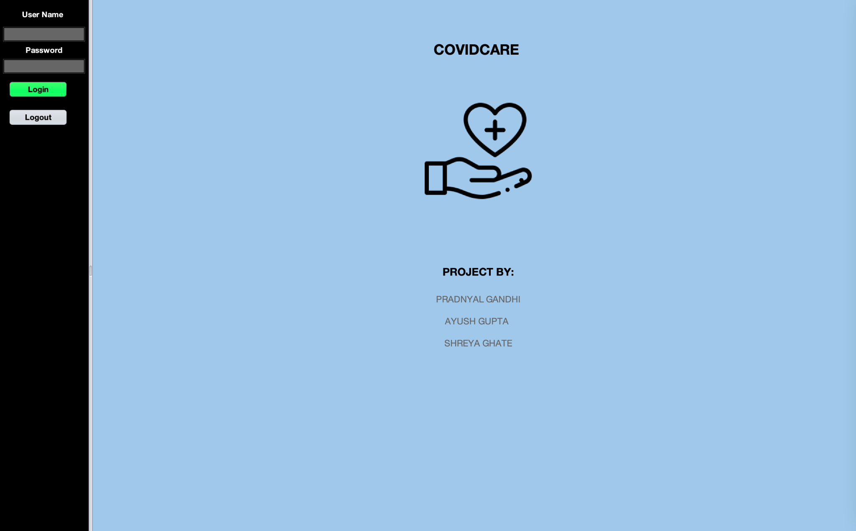

Slide 10
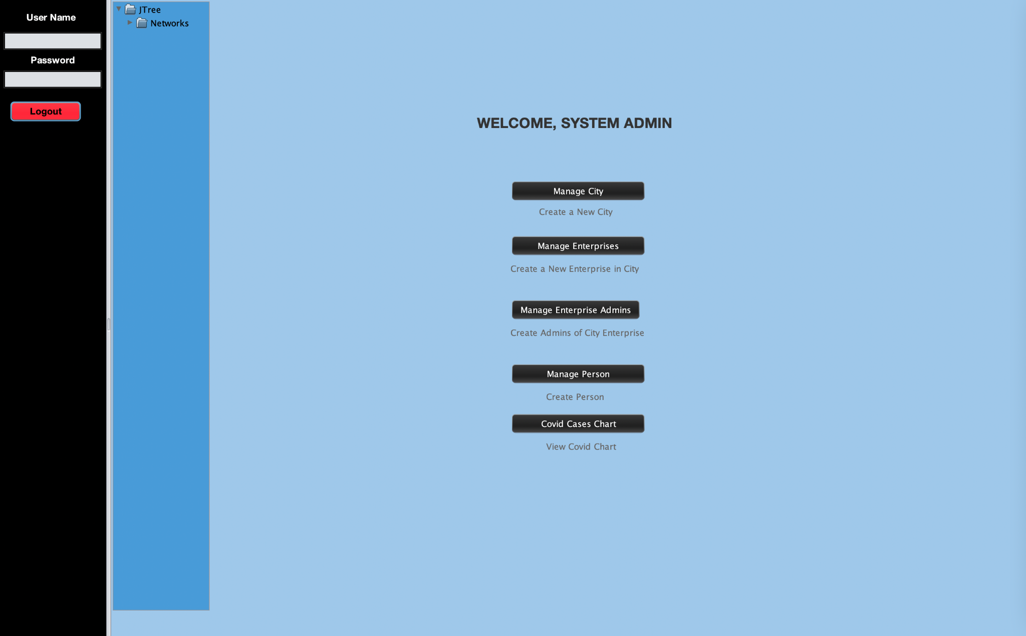

Slide 11
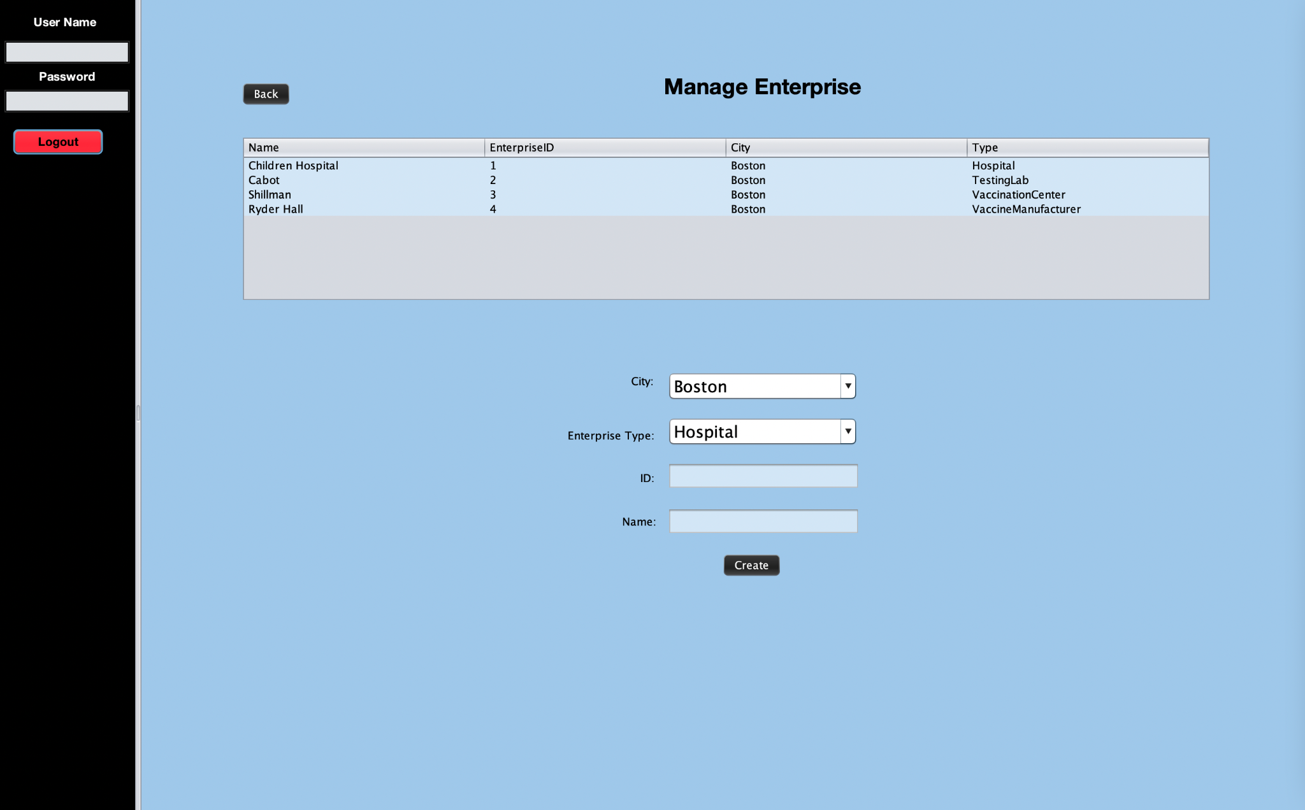

Slide 12
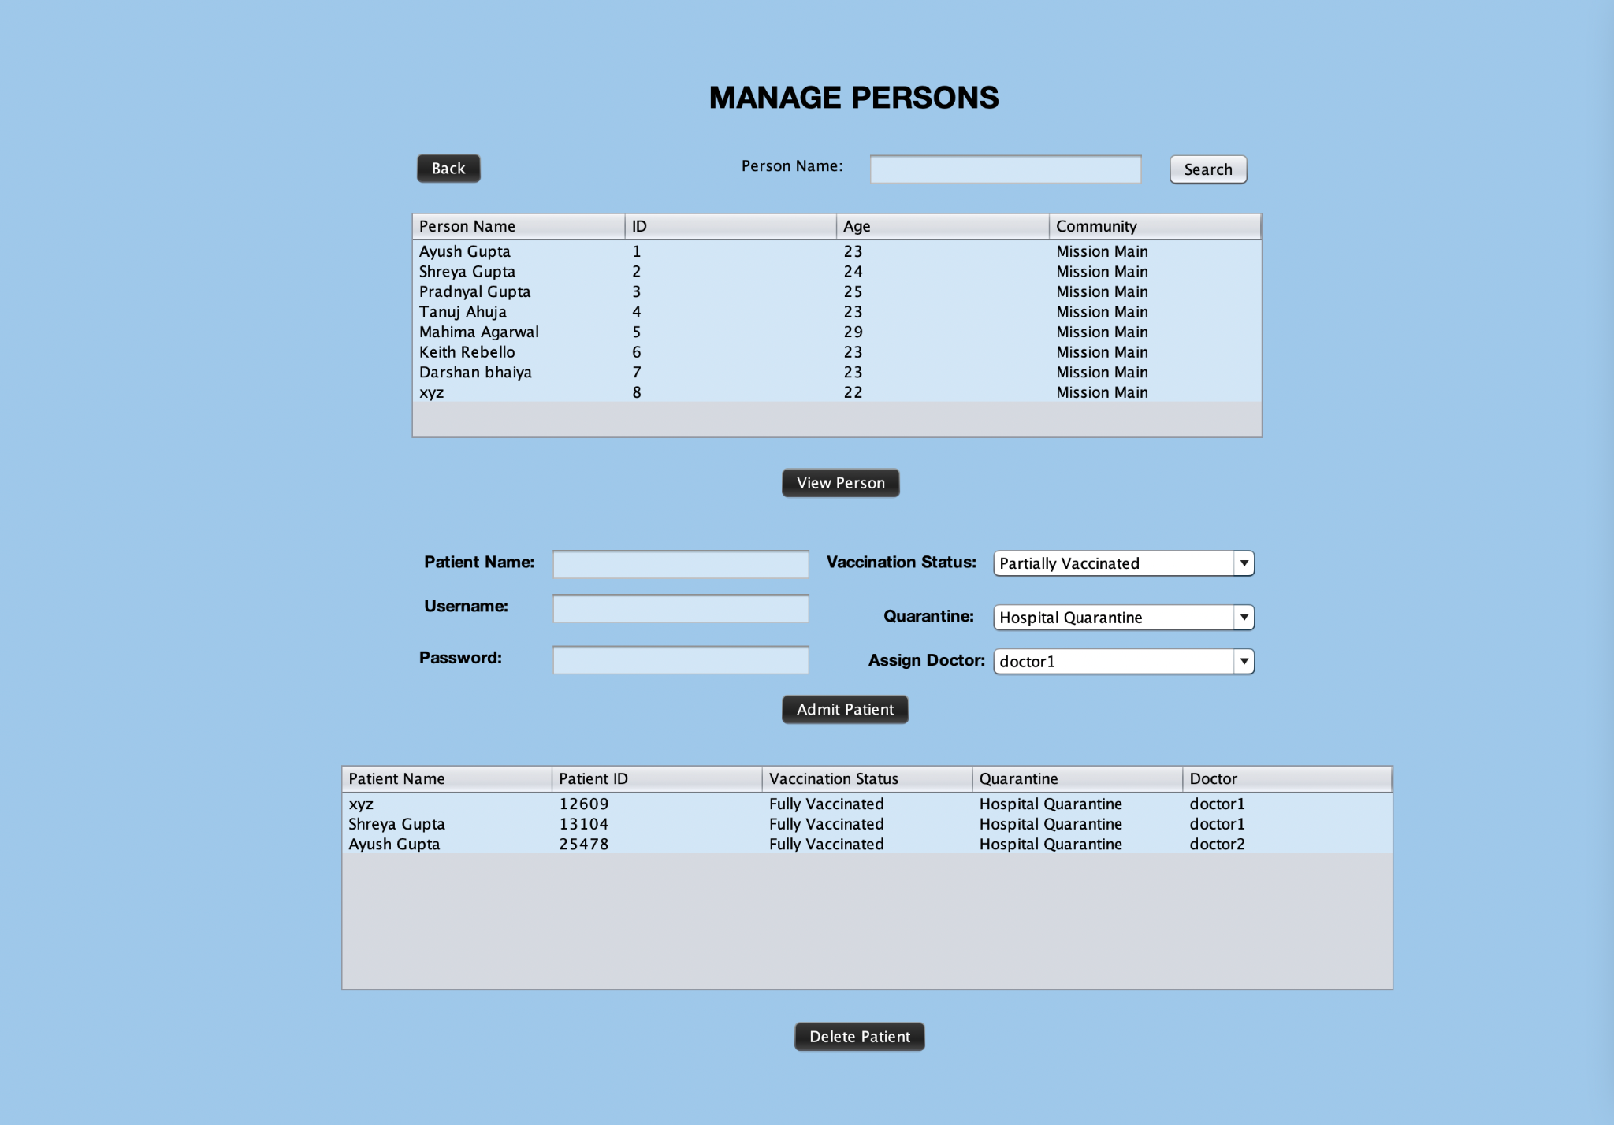

Slide 13
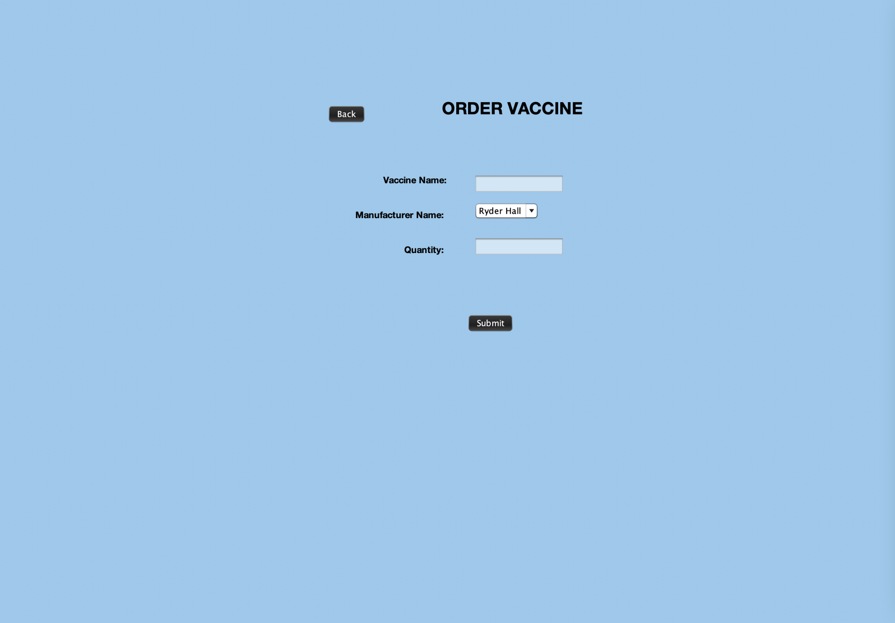

Slide 14
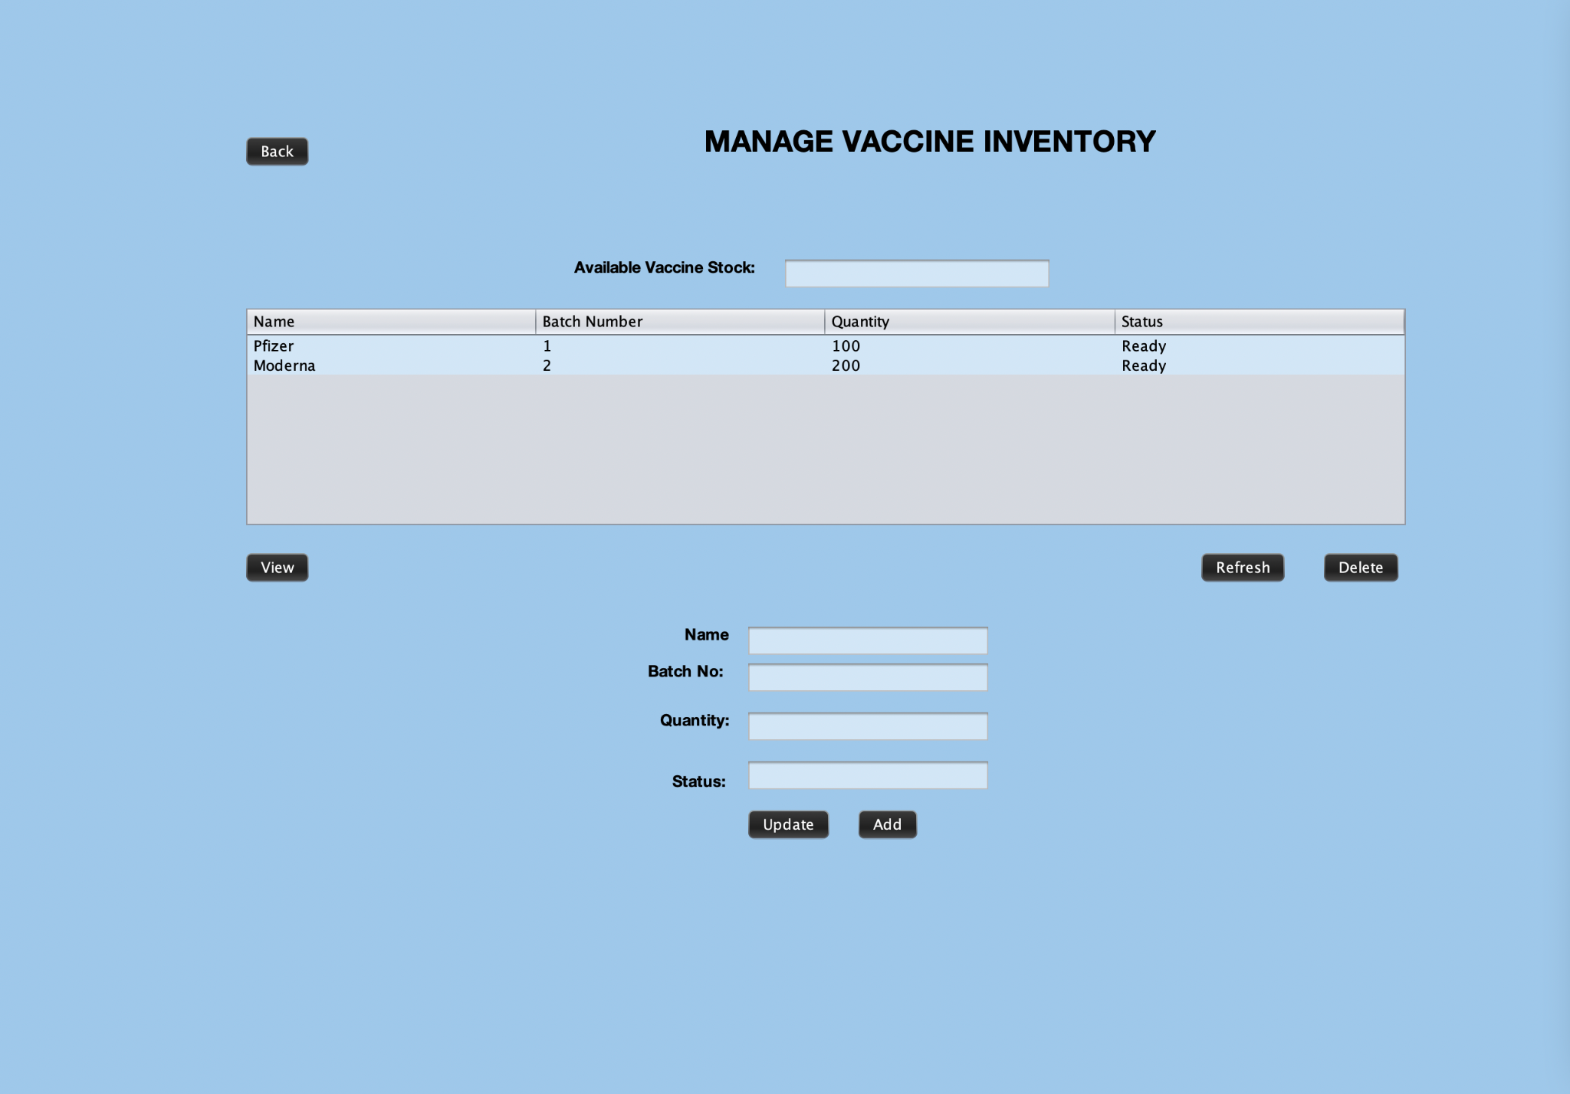
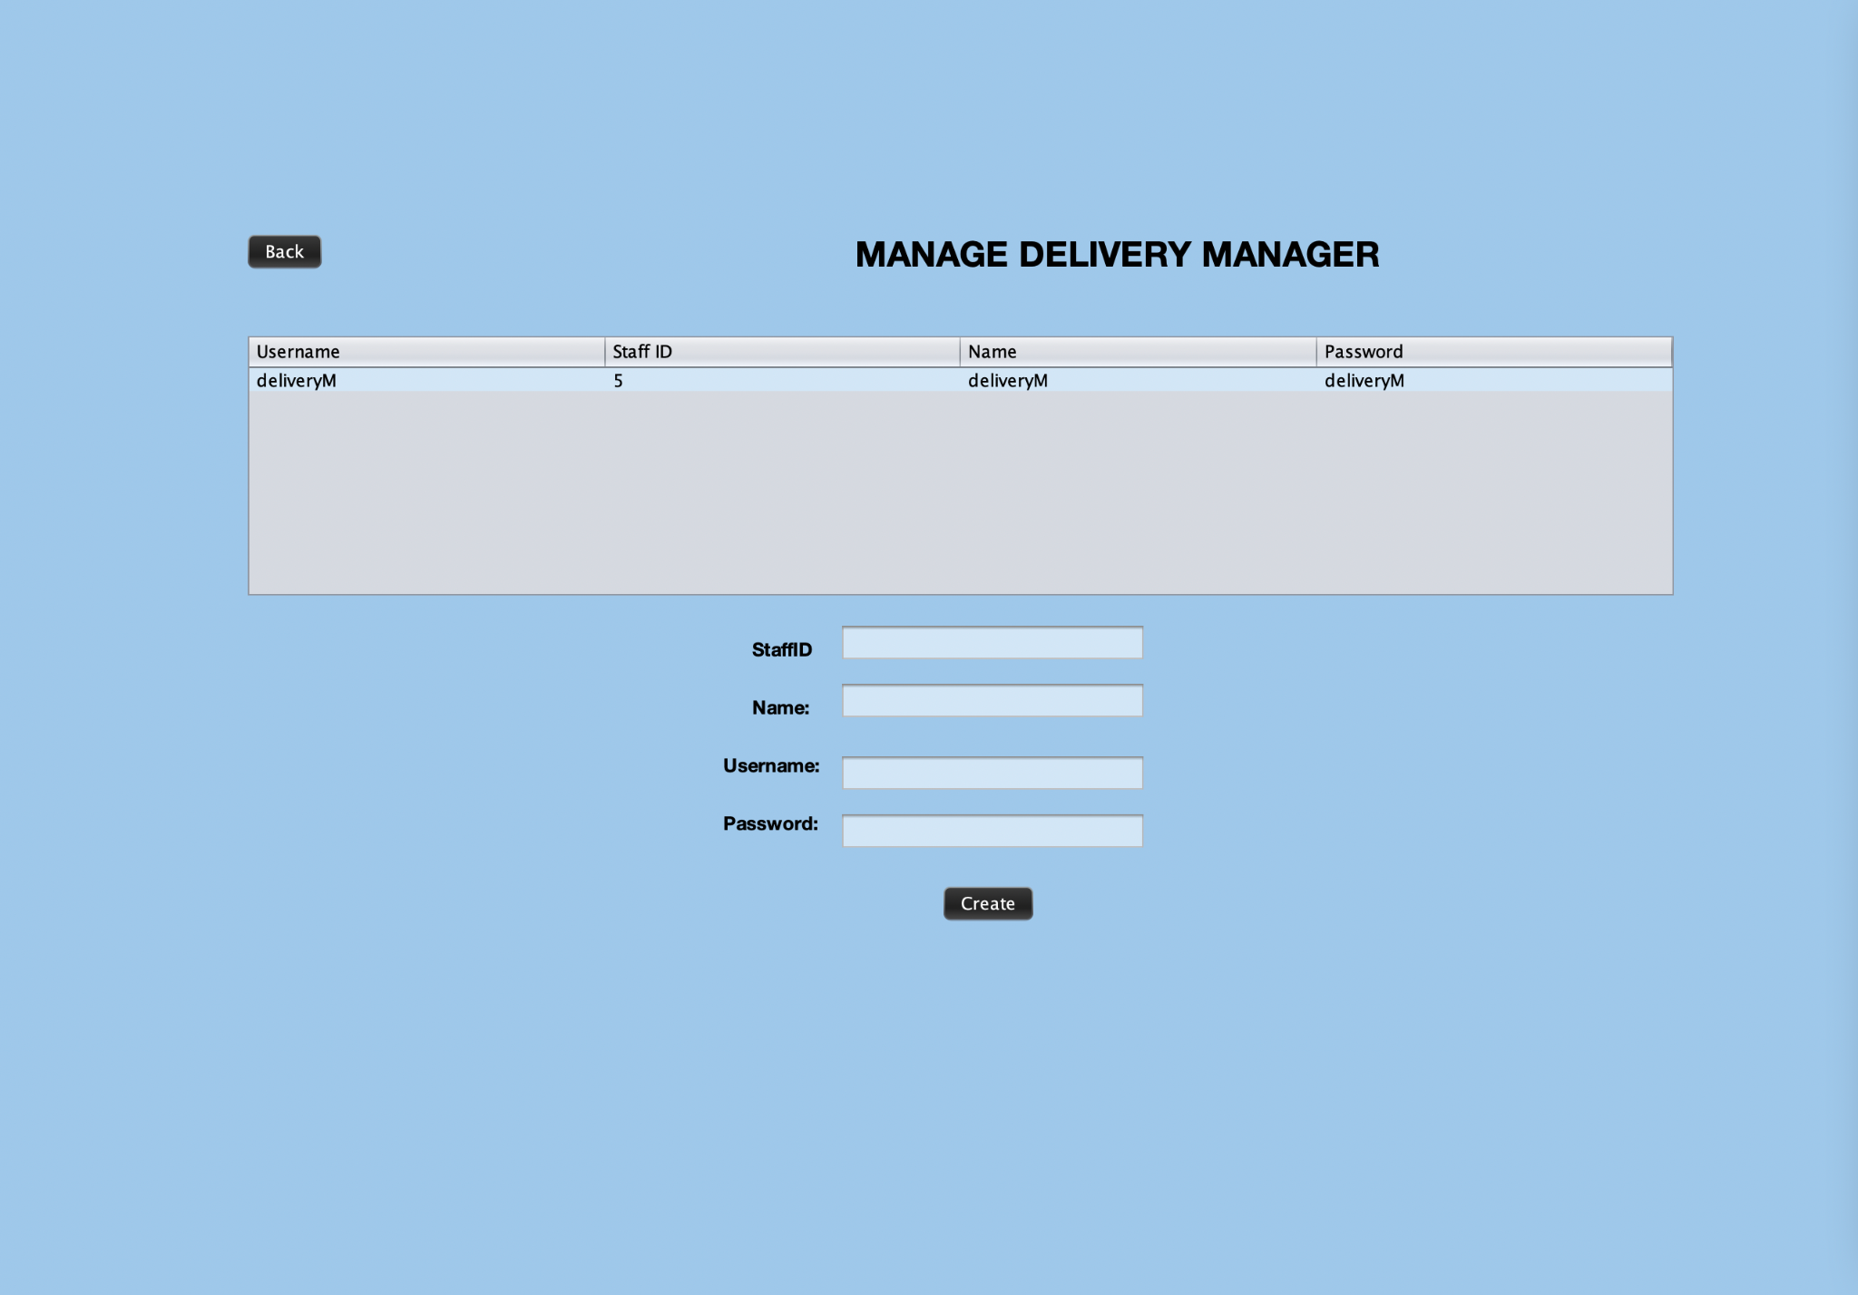

Slide 15
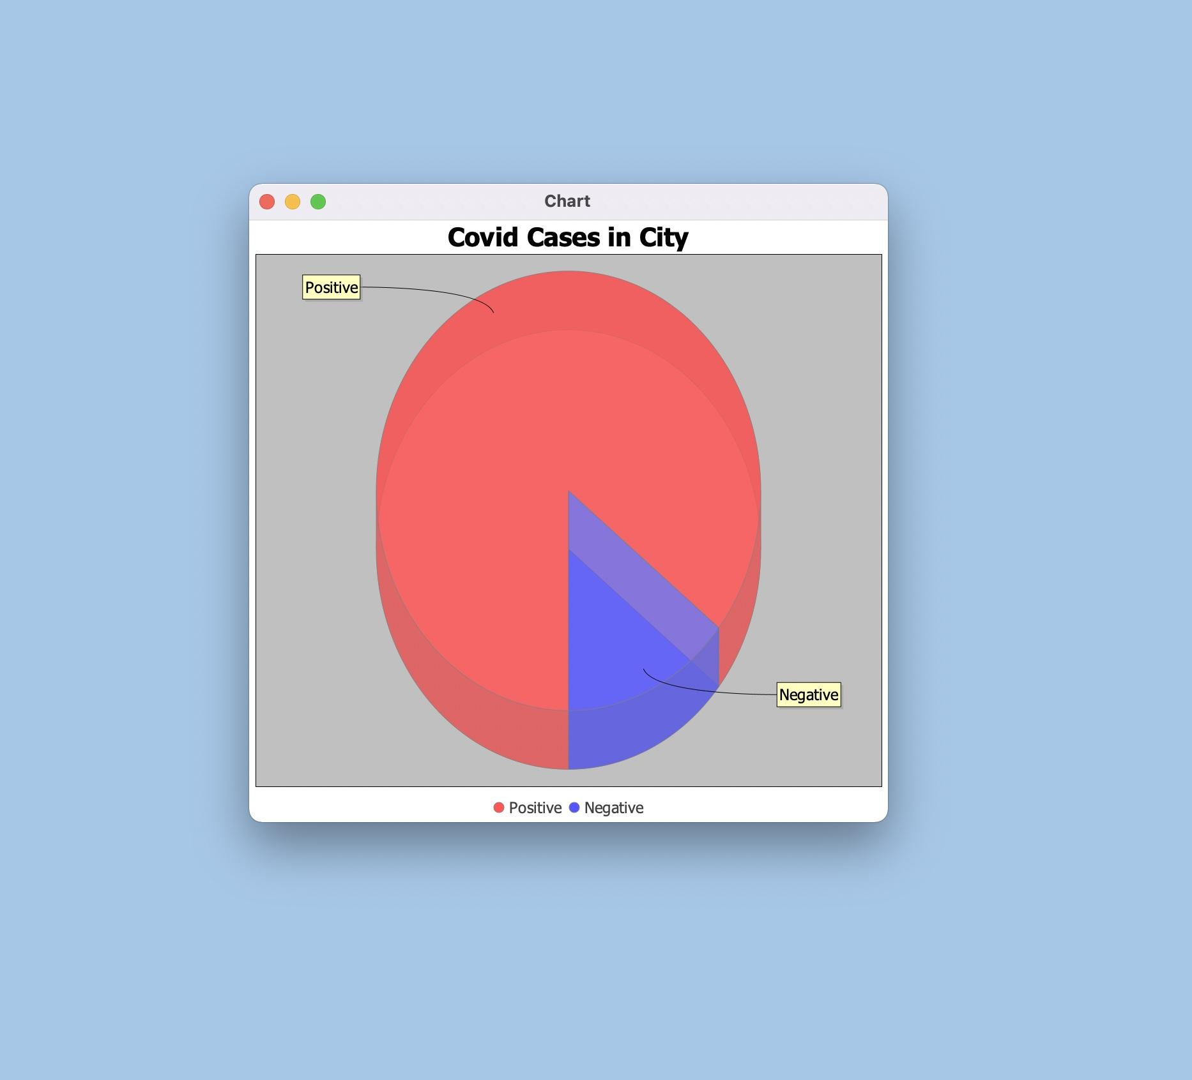

Slide 16
Thank you

